Slide 1


Abraham Jhared Flores Azcona
January 2nd, 2026

Slide 2

Outline
Executive Summary
Introduction
Methodology
Results
Conclusion
Appendix

Slide 3
Executive Summary
Our result findings suggest that the success of SpaceX as company for commercially reliable rocket launches is to be continued in the foreseeable future.
The data analysis pipeline consisted on data extraction from publicly available information, Exploratory Data Analysis using SQL to facilitate the queries, and different Machine Learning models that converge on our interpretation that the success trend will continue.

Slide 4


Introduction
SpaceX is a rocket launch company
Many have been quite skeptical about its future since the start of the company
The historical data analyzed suggests that success is the trend of this company
What is the historical launch success rate for the company?
Which launch sites are there in the US?
Which boosters offer the best success rate?
How much cargo weight can we employ to maintain the best-boosters success rate?

Slide 5

Section 1

Slide 6
Methodology
Executive Summary
Data collection methodology:
Webscraped data from the Wikipedia article to then port in into an CSV file
Perform data wrangling
Used pandas & SQL for easy manipulation and cleanup based in their APIs
Perform exploratory data analysis (EDA) using visualization and SQL
Perform interactive visual analytics using Folium and Plotly Dash
Perform predictive analysis using classification models

Slide 7
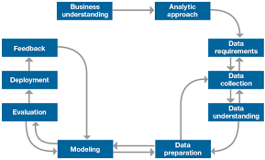
Data Collection
Webscraped the data from the Wikipedia entry, load the data into a dataframe to clean it
Afterwards, we made several SQL queries as Exploratory Data Analysis to gain insight on the landing sites
Using geospatial data, we mark on map the launching sites for reference
Then, we detect which has the highest success rate, and execute ML models to predict the future success rate

Slide 8
Data Collection – SpaceX API
Call the SpaceX API and get the required data from the expected endpoint for further analysis
GitHub URL: https://github.com/NotsoJharedtrollOx17/Module10_AppliedDataScienceCapstone/blob/main/00_DataCollection.ipynb
Convert To DataFrame
Download Data
getBoosterVersion()
getLaunchSite()
getCoreData()
Save DataFrame as CSV
Generate New DataFrame

Slide 9
Data Collection - Scraping
Basically, read the Wikipedia entry of launches and scrape the HTML table found inside.
GitHub URL: https://github.com/NotsoJharedtrollOx17/Module10_AppliedDataScienceCapstone/blob/main/01_HandsOnLab_Webscraping.ipynb
Convert To BeautifulSoup
Download Data
extractHTMLTables()
extractTableRows()
extractOthers()
Save DataFrame as CSV
Generate New DataFrame

Slide 10
Data Wrangling
By using pandas (a Data Science Python library), we where able to clean up and inject missing values per common procedure
GitHub URL: https://github.com/NotsoJharedtrollOx17/Module10_AppliedDataScienceCapstone/blob/main/02_HandsOnLab_DataWrangling.ipynb

Slide 11
EDA with Data Visualization
We plotted scatter plots, bar charts & histograms to get a glimpse into the payloads, launch sites & successes to expect a sensible model behavior
GitHub URL: https://github.com/NotsoJharedtrollOx17/Module10_AppliedDataScienceCapstone/blob/main/04_HandsOnLab_EDAVisualization.ipynb

Slide 12
EDA with SQL
In brief, the main queries made where:
Data counts
Range of values per successes
Locations of successful launches
Payloads per booster & location
Etc.
GitHub URL: https://github.com/NotsoJharedtrollOx17/Module10_AppliedDataScienceCapstone/blob/main/03_HandsOnLab_EDASQL.ipynb

Slide 13
Build an Interactive Map with Folium
We added the launch site markers, the labels of the sites, and the over counts as different regions in the map object
It is imperative to understand where the launches have taken place to assess which areas of the world may prevail in extending the successes of the company
GitHub URL: https://github.com/NotsoJharedtrollOx17/Module10_AppliedDataScienceCapstone/blob/main/05_InteractiveVisual.ipynb

Slide 14
Build a Dashboard with Plotly Dash
We added a pie chart and a scatterplot of the overall successes within site, and the success/failure launch result within site
It is necessary to display a brief glimpse of the successes per site, which can help executives to gain insight clearly
GitHub URL: https://github.com/NotsoJharedtrollOx17/Module10_AppliedDataScienceCapstone/blob/main/06_HandsOnLab_InteractiveDashBoardScript.py.txt

Slide 15
Predictive Analysis (Classification)
Evaluated 4 models with GridSearchCV: i) LogisticRegression, ii) SVC, iii) DecisionTreeClassifier & iv) KNeighborsClassifier
With the given data, we preprocess the dataset into train/test splits and then start training each of the variants with GridSearchCV to find the best model overall that estimates the launch success
GitHub URL: https://github.com/NotsoJharedtrollOx17/Module10_AppliedDataScienceCapstone/blob/main/07_HandsOnLab_ML.ipynb

Slide 16
Results
Exploratory data analysis results
Interactive analytics demo in screenshots
Predictive analysis results

Slide 17

Section 2

Slide 18
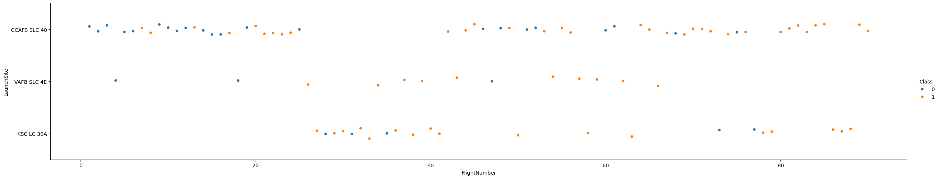
Flight Number vs. Launch Site
CCADFS SLC 40 has a greater number of orange dots, indicating a greater success number of flights

Slide 19
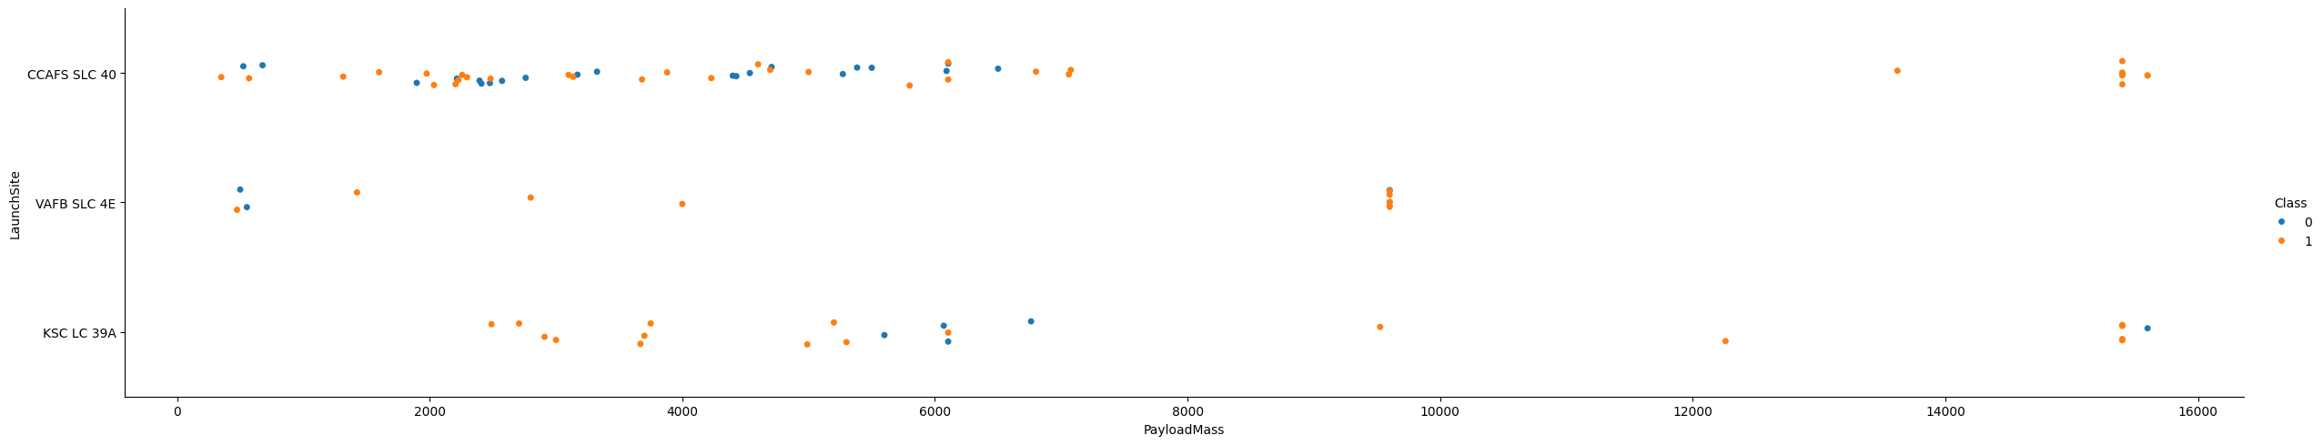
Payload vs. Launch Site
Overall, from 2000 kg to 6000 kg, the successful launch count is greater.

Slide 20
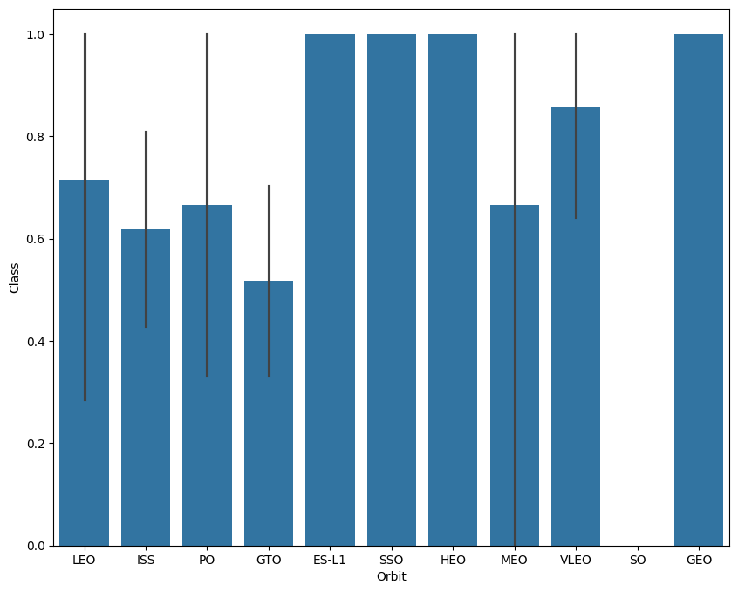
Success Rate vs. Orbit Type
ES-L1, SSO, HEO & GEO orbits are the ones that show a greater success rate bar none.

Slide 21
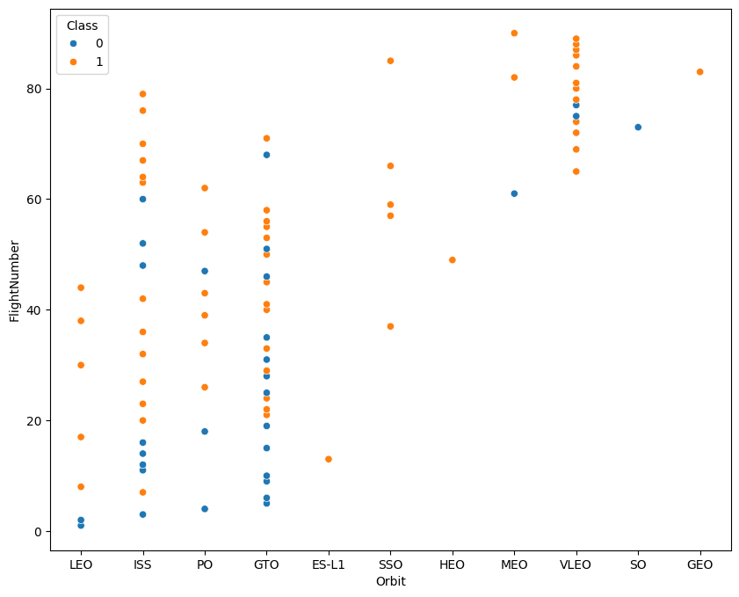
Flight Number vs. Orbit Type
In contrast to the previous bar chart, this plot indicates that the most truthful successes are present in the LEO, ISS, PO & VLEO
The other previously accounted success orbits seems to suffer from a lot of positive confirmation bias

Slide 22
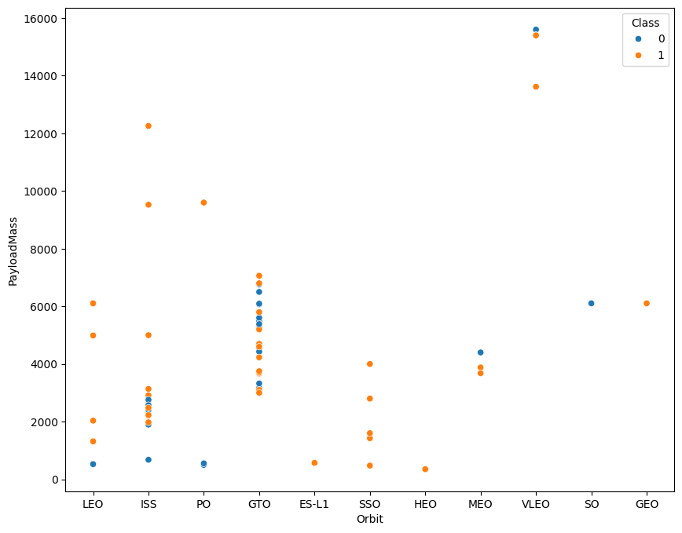
Payload vs. Orbit Type
In a similar manner to the Payload Mass plot from before, the reliable threshold for the Payload to estimate success is from 2000 kg to 6000 kg
Other orbits seem to have greater success under lower payloads

Slide 23
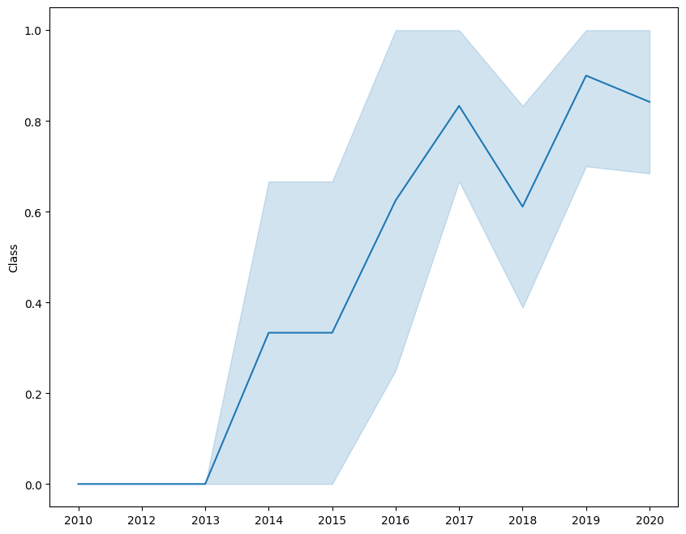
Launch Success Yearly Trend
If historical data around the launches is to be trusted, we can expect that the successful launches will be much more common occurrence than before.

Slide 24
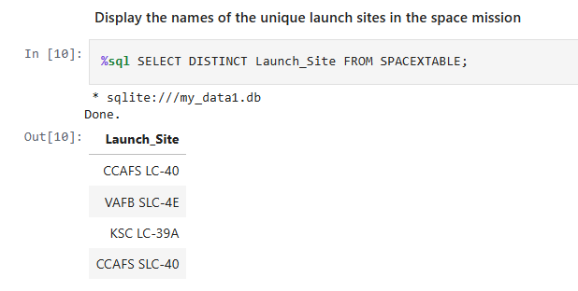
All Launch Site Names
Find the names of the unique launch sites
Current query shows a unique launch site that did not appeared in the plots (CCAFS SLC-40)

Slide 25
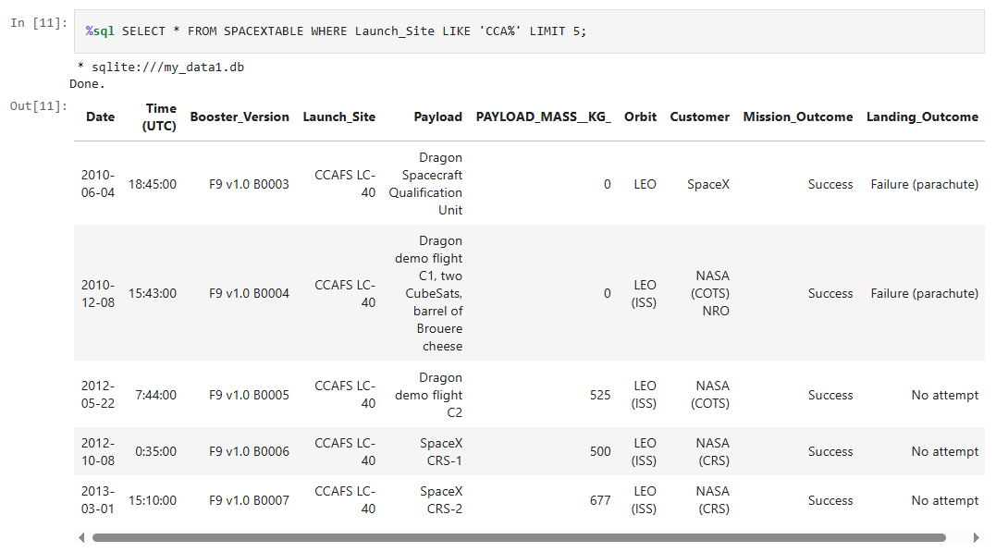
Launch Site Names Begin with 'CCA'
Find 5 records where launch sites begin with `CCA`
We can appreciate that the query obtained successful launches from the get-go

Slide 26
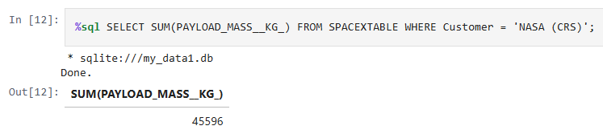
Total Payload Mass
Calculate the total payload carried by boosters from NASA
One of their customers, NASA, has launched 45596 kg total!

Slide 27
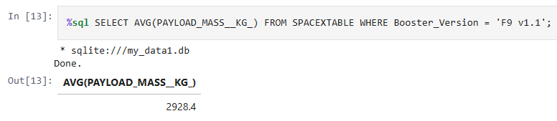
Average Payload Mass by F9 v1.1
Calculate the average payload mass carried by booster version F9 v1.1
Our focus for one of the boosters, has launched ~ 2928 kg total!

Slide 28
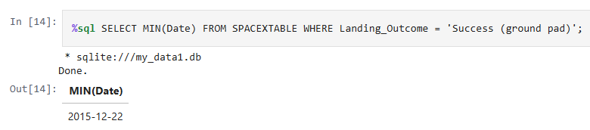
First Successful Ground Landing Date
Find the dates of the first successful landing outcome on ground pad
The first successful capture of any booster happened in late 2015!

Slide 29
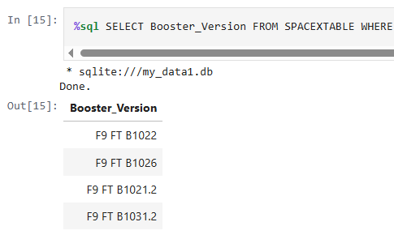
Successful Drone Ship Landing with Payload between 4000 and 6000
List the names of boosters which have successfully landed on drone ship and had payload mass greater than 4000 but less than 6000
A notable observation is that F9-variant boosters can carry those weight ranges!

Slide 30
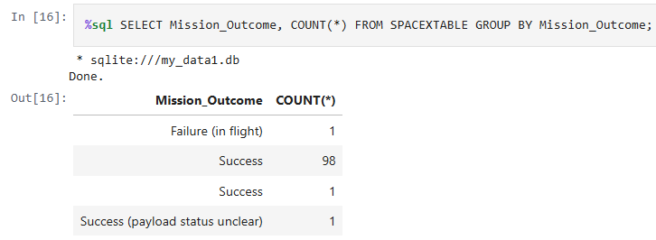
Total Number of Successful and Failure Mission Outcomes
Calculate the total number of successful and failure mission outcomes
Curiously enough, most launches have been considered successes!

Slide 31
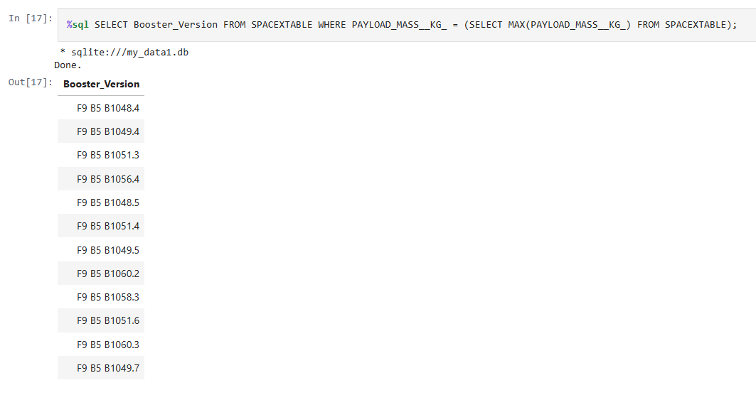
Boosters Carried Maximum Payload
List the names of the booster which have carried the maximum payload mass
F9-variant boosters also successfully launch their max payloads!

Slide 32
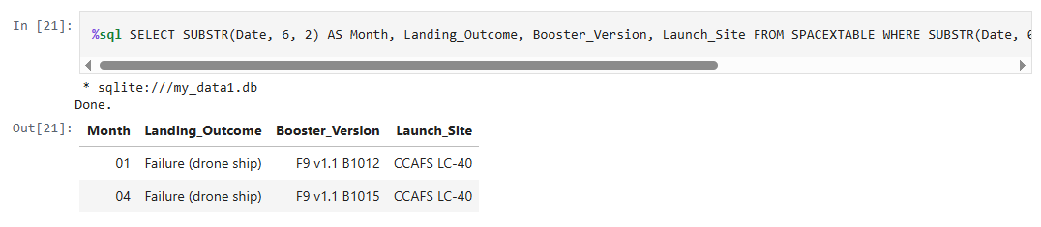
2015 Launch Records
List the failed landing_outcomes in drone ship, their booster versions, and launch site names for in year 2015
January and April 2025 suffered the most defining failures of launch

Slide 33
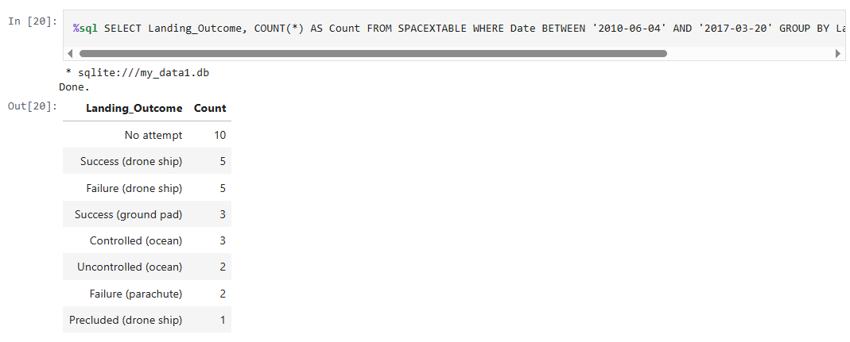
Rank Landing Outcomes Between 2010-06-04 and 2017-03-20
Rank the count of landing outcomes (such as Failure (drone ship) or Success (ground pad)) between the date 2010-06-04 and 2017-03-20, in descending order
Most of the dataset consists of launches that were not attempted!

Slide 34

Section 3

Slide 35
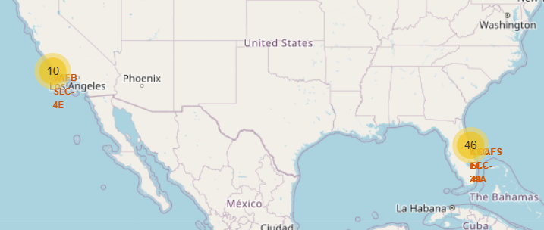
Area of Operations (AO)
As we tend to expect, all launch sites analyzed belong to the United States of America
Launch sites are geographically divided into the East Coast & West Coast respectively
West Coast
East Coast

Slide 36
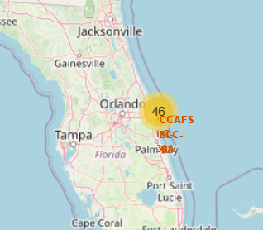
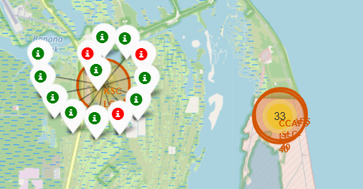
East Coast’s AO
Most Launches Happen in Cabo Cañaveral
They’re further separated into inland Cabo (where most green markers appear), and the actual NASA property (the 33 count)
We may expect that most successful launches happen there

Slide 37
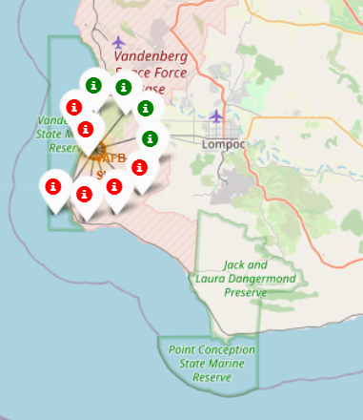
West Coast’s AO
Most of the launches are near a military base.
Interestingly, the launch site is around a very isolated area, which may influence the risk assessment of the launches.

Slide 38

Section 4

Slide 39
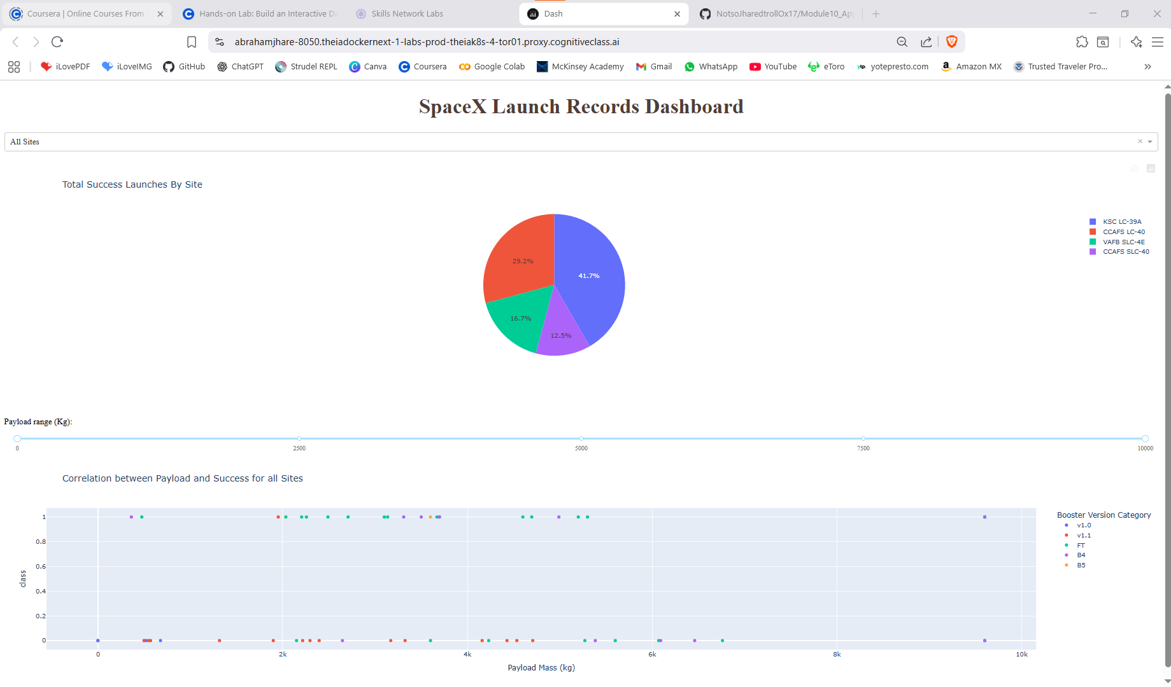
Launch Success for All Sites
Overall successes happen with a payload of 2000 kg to 6000kg

Slide 40
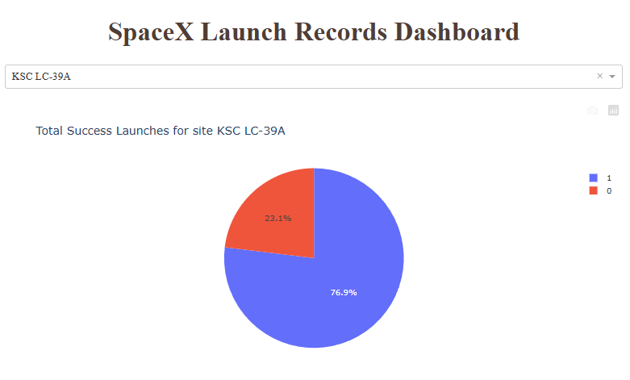
Launch Success for the Best Site
We can see that the best site has a success rate of ~ 77% !

Slide 41
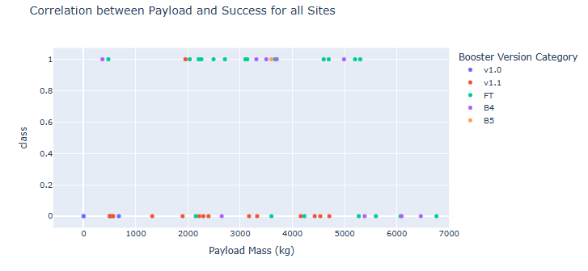
Payload and Success
For our successful range (2000 kg to 6000 kg) we can appreciate that the most performant booster category is the FT category, where our F9-variant belongs!

Slide 42

Section 5

Slide 43
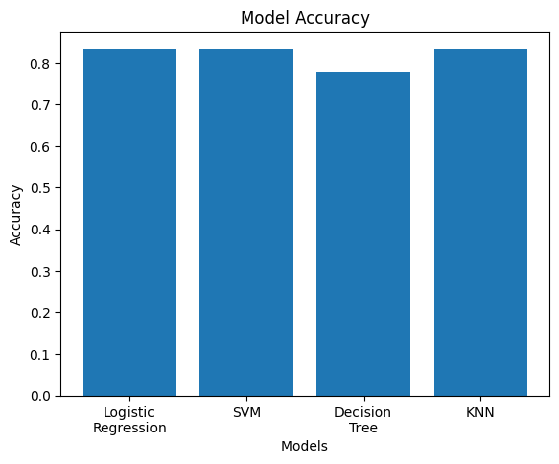
Classification Accuracy
After ML modelling, we found that, with the current data available, all models except the decision tree obtained a better classification record overall.
The exception, the Decision Tree, seems to have an extra account of False Negatives that suggests this model may tamper with estimations under a larger dataset.

Slide 44

Confusion Matrix
As stated previously, all the other models seem to possess a better confusion matrix with lesser False Negatives.
For our criteria, better prediction around all models indicate sufficient evidence for trusting the models.

Slide 45
Conclusions
SpaceX launch success can be expect for the long term
The East Coast overall seems to have more successful launches due to its close proximity to NASA’s compounds
The F9-variant boosters offer the most reliable launch success rate
Around 2000 kg to 6000 kg can be launched to expect a successful launch

Slide 46
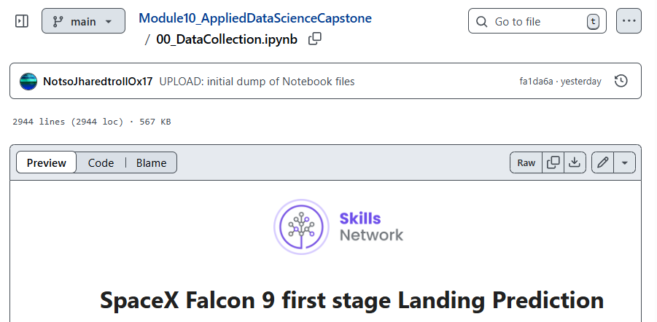
Appendix

Slide 47
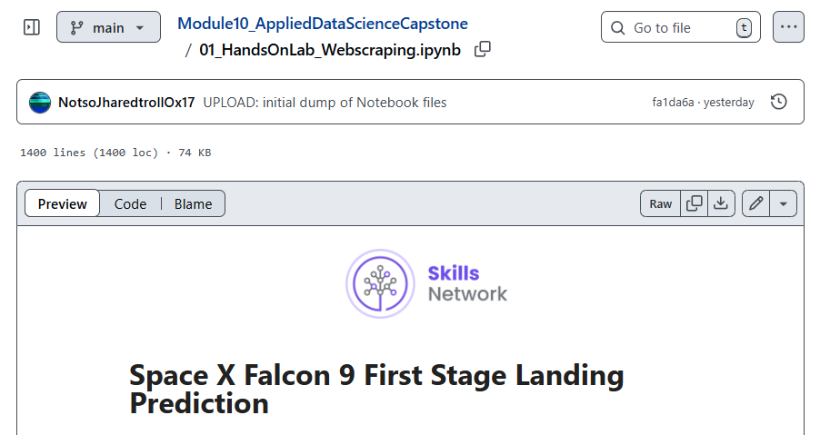
Appendix

Slide 48
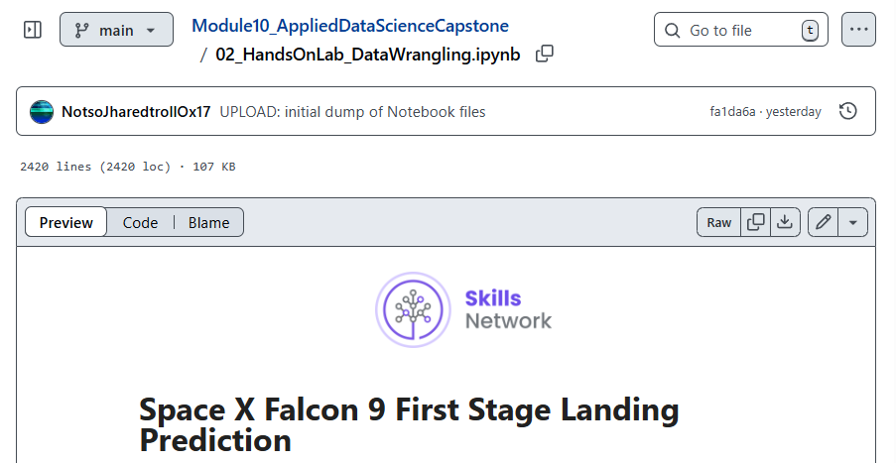
Appendix

Slide 49
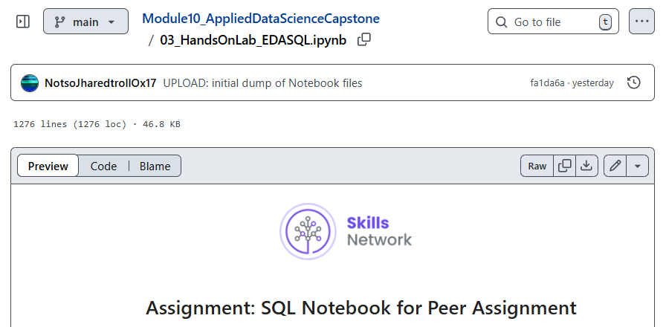
Appendix

Slide 50
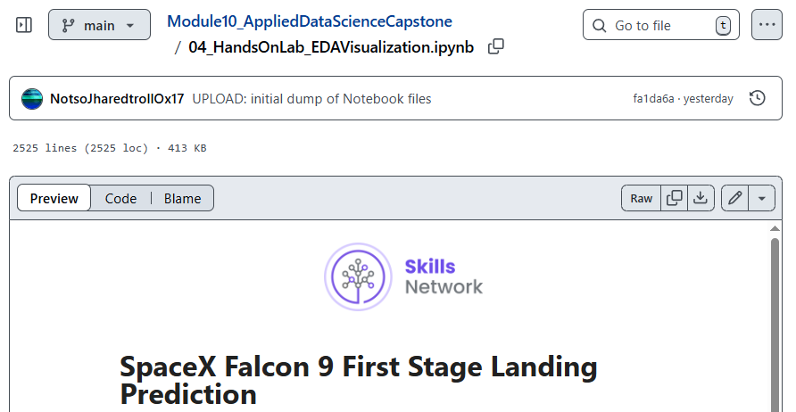
Appendix

Slide 51
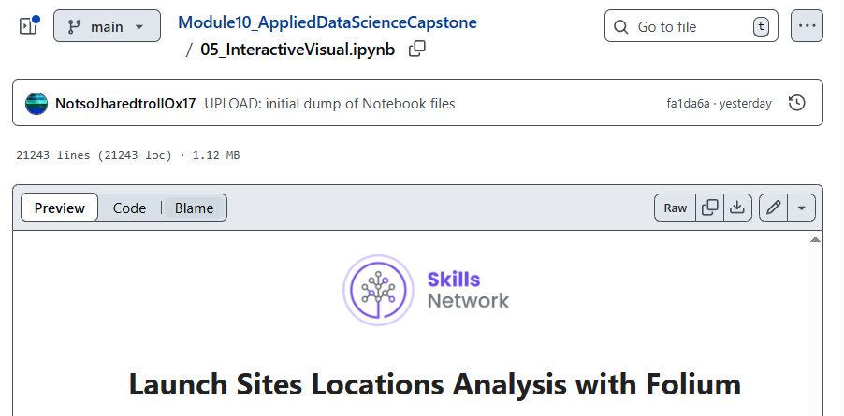
Appendix

Slide 52
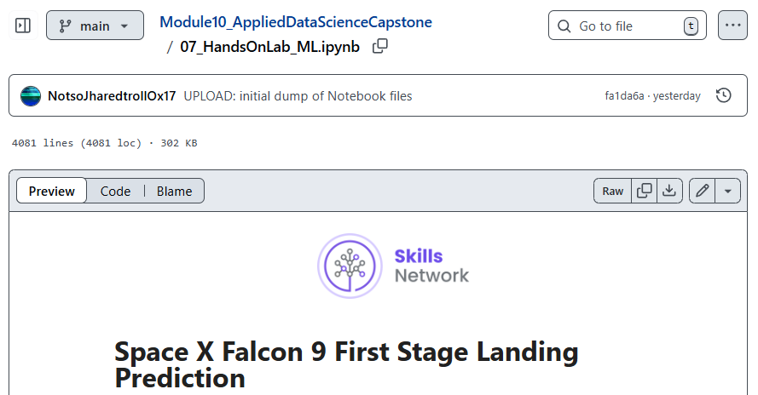
Appendix

Slide 53


